Slide 1
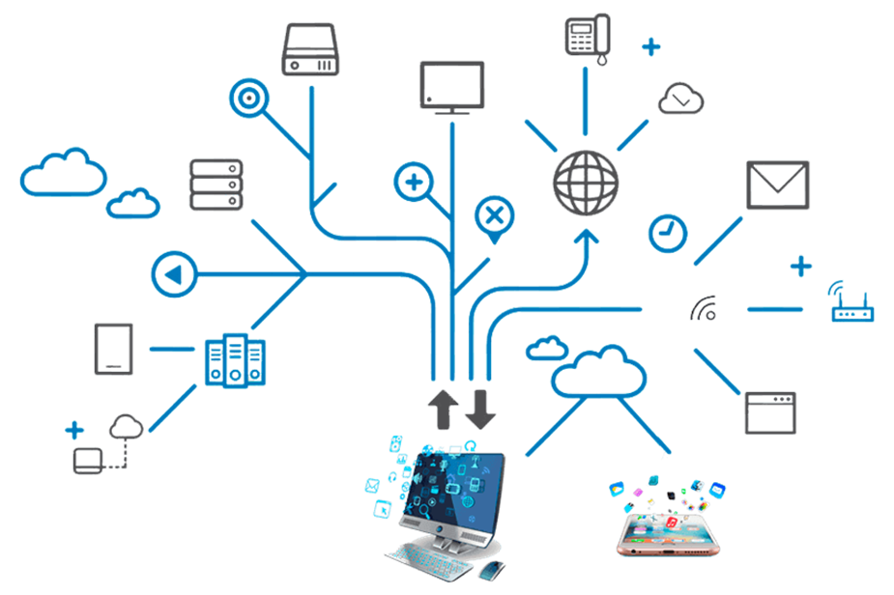
IoT Internet of Things
Dr. Bhale Pradeepkumar, IIITDM

Slide 2
Contents
Overview of IoT
History of IoT
Advantages of IOT
Challenges of IOT
Architecture of IOT
Devices and Network
Applications of IOT
IOT Tools and Platforms

Slide 3
Overview of IoT
Internet of Things (IoT) refers to a system of interrelated, internet-connected objects that are able to collect and transfer data over a wireless channel without human intervention
IoT describes the network of physical objects - “things” - that are embedded with sensors, software, and other technologies for the purpose of connecting and exchanging data with other devices and systems over the internet
IoT enables to analyze and act on data, facilitating the decision making process with aid of insights obtained

Slide 4





Overview of IoT
Insights aid in transforming business and lower costs with aid of reliable real-time data through,
Reduction of wasted materials
Streamlined Operational and Mechanical Processes
Expansion into new lines of business

Slide 5




IoT – How it Works?
Sensors/Devices
Data Processing
Collecting data
Making data useful
Connectivity
User Interface
Sending data to cloud
Delivering information to user

Slide 6
History Of IoT
Carnegie Mellon University’s . David Nichols - ARPANET based Monitoring - Coke Vending Machine
John Romkey developed a toaster that could be turned on and off over the Internet
IoT conference was held at Zurich
US National Intelligence Council included IoT as Disruptive Civil Technologies
1989
1999
1982
Tim Berners Lee
World Wide Web
1990
Kevin Ashton
Linking RFID in P&G’s supply chain to the Internet
Coined the term IoT
2008

Slide 7
2020
2015
2010
7.8 billion
50 billion
6.58
7.2 billion
25 billion
3.47
2003
6.8 billion
12.5 billion
1.84
6.3 billion
500 million
0.08
* CISCO Report

Slide 8




Economic Impact of IoT
$2.3 trillion
$4
trillion
$5
trillion
$7
trillion
2014
2016
2018
2020
* Gartner’s Survey

Slide 9
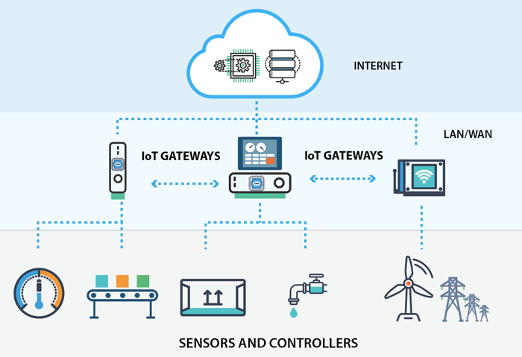
IoT Architecture
Things, Sensors and Controllers
Gateways and Data Acquisition
Edge Analytics
Data Centre / Cloud Platform

Slide 10
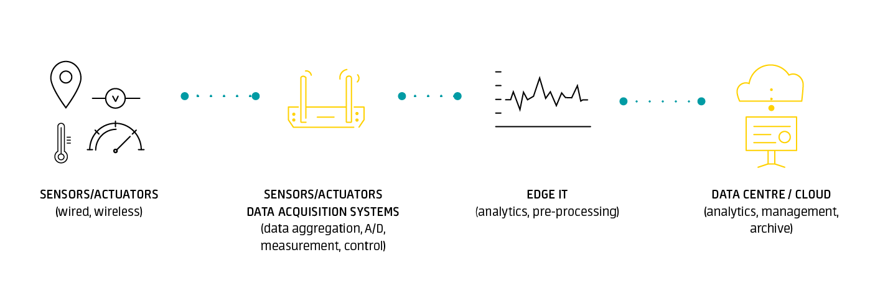
Layers in IoT Architecture

Slide 11
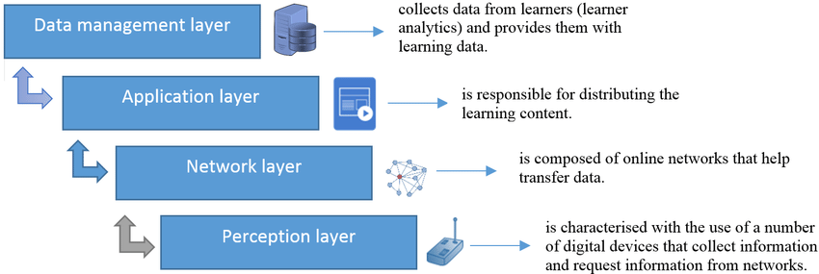
Layers in IoT Architecture

Slide 12





Factors Spurring Rapid IoT Expansion
Falling sensor costs
Falling costs of data collection and storage
Widely expanding internet connectivity
Increasing computing power
Increasing smartphone and tablet penetration

Slide 13



Advantages of IoT
Efficient Resource Utilization
Minimize Human Effort
Save Time
Improve Security
Enhance Data Collection
Enhance Data Collection
IoT Interact and Communicate
Reduces the Human Effort
Automatically
Secure and Efficient

Slide 14
Disadvantages of IoT
01
Security Network Attacks
02
Privacy
03
Complexity Designing, Developing, and Maintaining

Slide 15
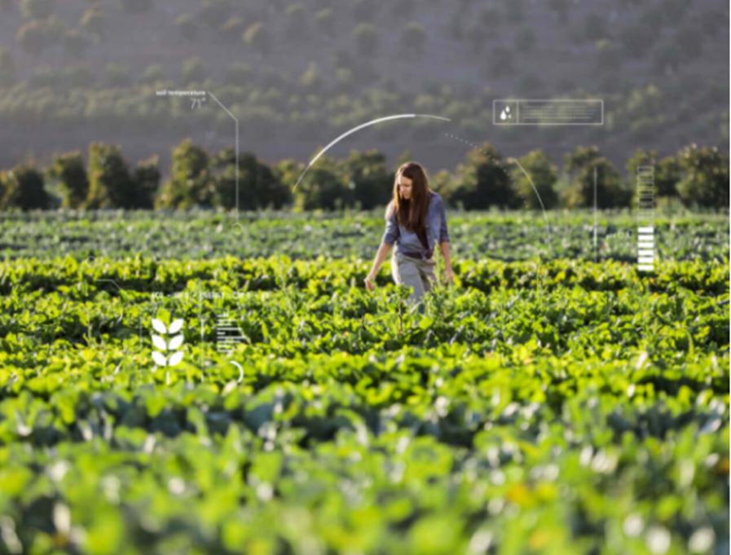
Remote Monitoring
Monitor – Machineries, Vehicles, Crops and Livestock
Monitor anywhere, either continuously or at regular intervals
Track location, performance, condition, or environmental factors
Insights aid in,
Reduce service costs and refine business processes
Understand how products are performing to provide a better experience for your customers
Increase the number of appointments per day, cut fuel costs, and reduce wear-and-tear by using machine learning capabilities to route freight or vehicles more efficiently
Know where resources are at any given moment—down to which vehicle they’re on—for improved field service, stronger security, and increased employee safety

Slide 16
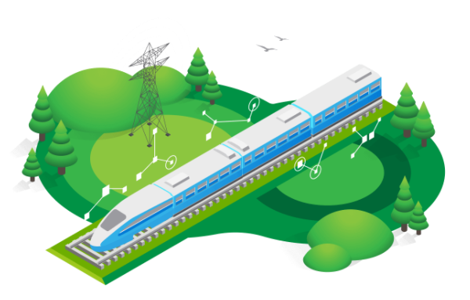
Predictive Maintenance
Predictive maintenance incorporates machine learning software that analyzes data to predict outcomes and automate actions
Predictive capabilities allow service providers to move beyond the traditional reactive and scheduled maintenance business model and use their data to identify issues before they become critical
Insights aid in,
Figuring out what mechanical or operational conditions are causing failures or slowdowns
Better predict what spare parts to keep in inventory before repair issues arise
Move beyond a break/fix business model by preventing equipment failures through preventative maintenance

Slide 17

Facilities Management
Monitoring buildings, infrastructure, and other spaces, allowing to improve energy efficiency, space utilization, productivity, and safety using the data collected
Insights aid in,
Saving money by automating lighting or optimizing heating and cooling cycles
Increasing employee or occupant satisfaction by keep equipment running or ensuring that supplies are stocked

Slide 18
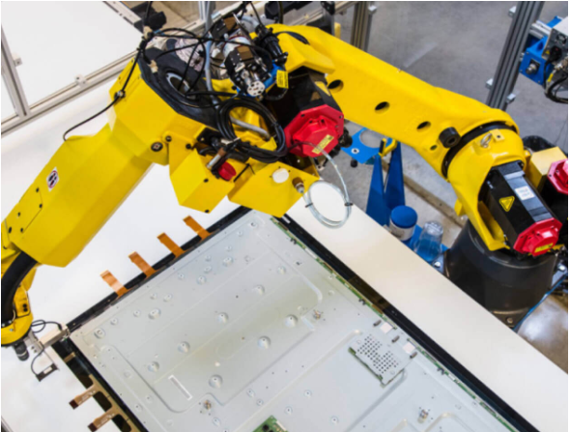
Manufacturing Efficiency
To manage processes and product quality with data from your devices and sensors
Insights aid in,
Identifying bottlenecks that reduce efficiency, enabling to improve process
Reducing downtime caused by unplanned maintenance or equipment failure
Eliminating substandard materials, parts, or errors before the product is complete
Reducing downtime caused by unplanned maintenance or equipment failure

Slide 19
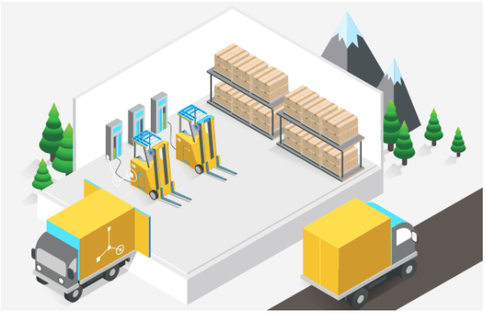
Connected Products – Supply Chain Management
Connected products have smart, connective components that allow data to be exchanged between the product and its user, manufacturer, or environment
Insights aid to,
Streamline the development and maintenance of products
Provide more secure, connected experiences for customers
Create new lines of business with managed service and support
Monitor how products perform to improve design, manufacturing, and reliability

Slide 20
Challenges in IoT adoption
1
3
Hardware platforms enable wide range of applications
Privacy and Security
2
4
Data Planning
Data Generated
Data Collection
Sustainability
Powered on 24/7

Slide 21
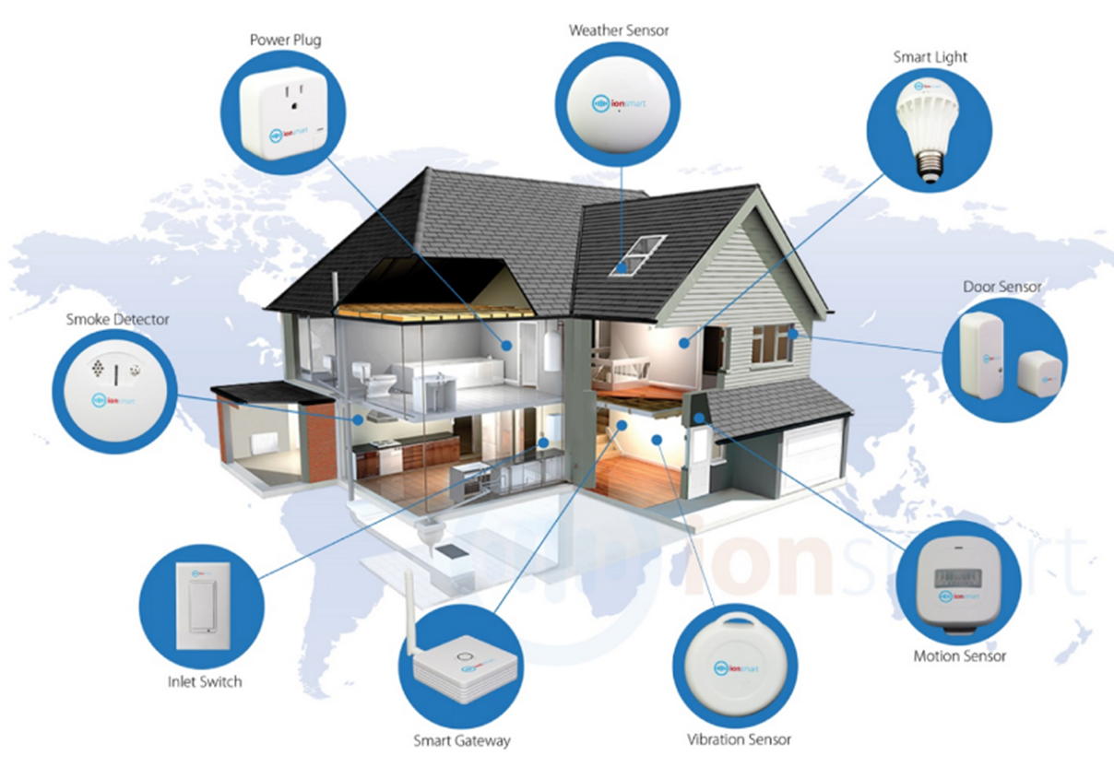
Smart Home
Control and Monitoring
Cost and Energy Savings
Environment Impact
Better Security
Comfort

Slide 22
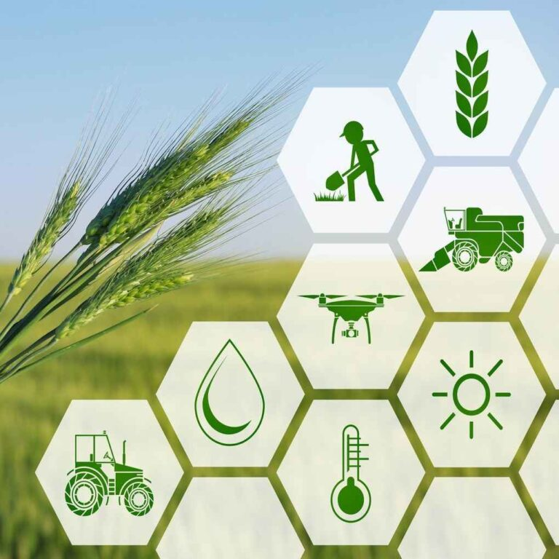
IoT in Agriculture
Precise Farming
Agriculture Drones
Livestock Monitoring
Smart Greenhouses

Slide 23
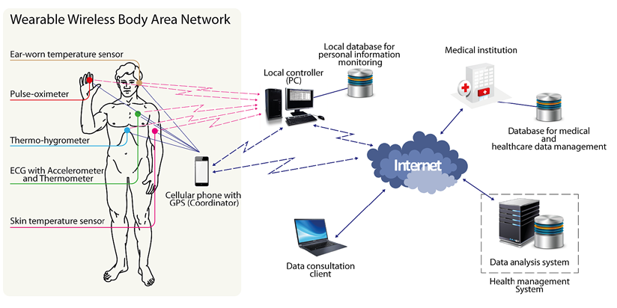
IoT in Health Care
Remote Patient Monitoring
Promoting Hygienic Hospitals and Clinics
Depression and Mood Monitoring
Pharmaceutical Temperature Monitoring

Slide 24
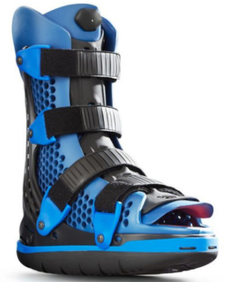
Case Study: Health Care
Diabetic foot ulcers (DFUs) are a leading cause of hospitalizations in the US for diabetics. The primary course of treatment for DFUs is an offloading device or non-removable cast, but compliance often remains a significant challenge, leading to a high treatment failure rate among patients with DFUs. Healing time can be accelerated with therapeutic footwear optimized via plantar pressure analysis to take weight and pressure off the area of ulceration.
To help providers personalize care and improve compliance, Sensoria partnered with leading DFU boot manufacturer, Optima Molliter, to create the Motus Smart Solution. These connected devices enable clinicians to remotely monitor patients when they leave the clinic to better track patient compliance and improve care plans.

Slide 25
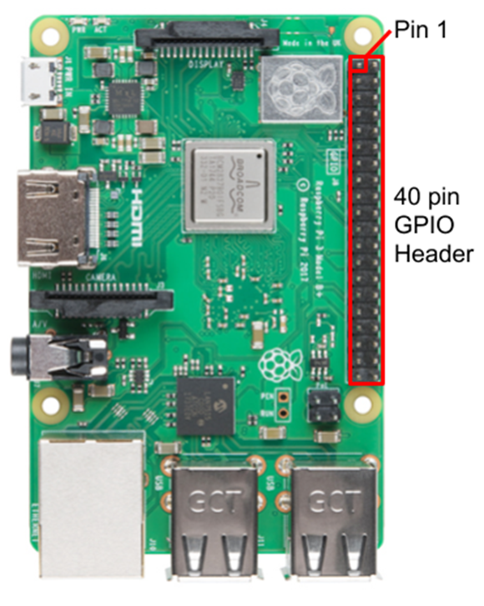
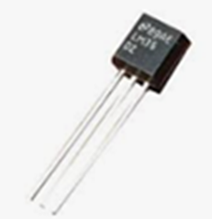
IoT Tools & Platforms
Raspberry Pi
Arduino
The Raspberry Pi is a low cost, credit-card sized computer that plugs into a computer monitor or TV and uses a standard keyboard and mouse
Arduino is a prototype platform (open-source) based on an easy-to-use hardware and software
It consists of a circuit board, which can be programed (referred to as a microcontroller) and a ready-made software called Arduino IDE

Slide 26
Thank You

Slide 27
Appendix

Slide 28
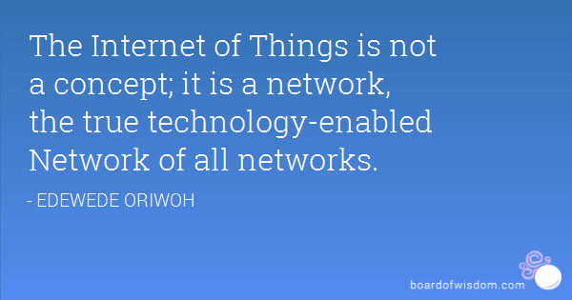
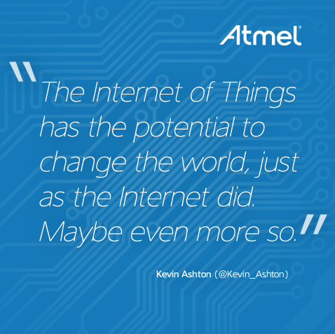
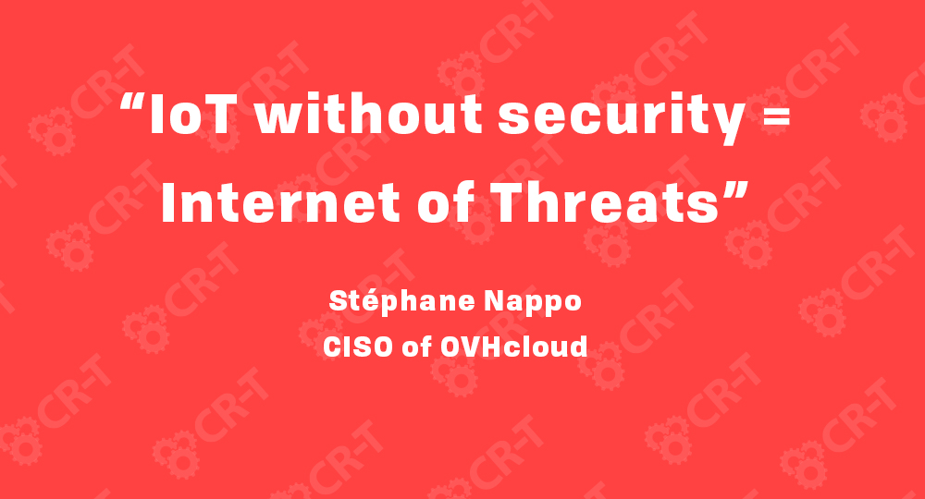
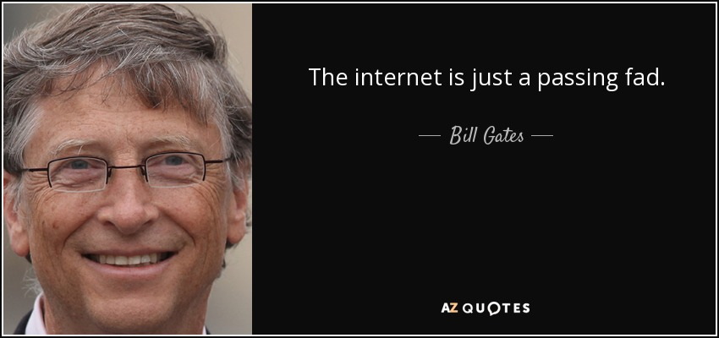
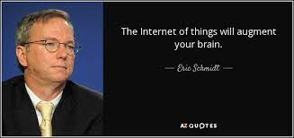

Slide 29
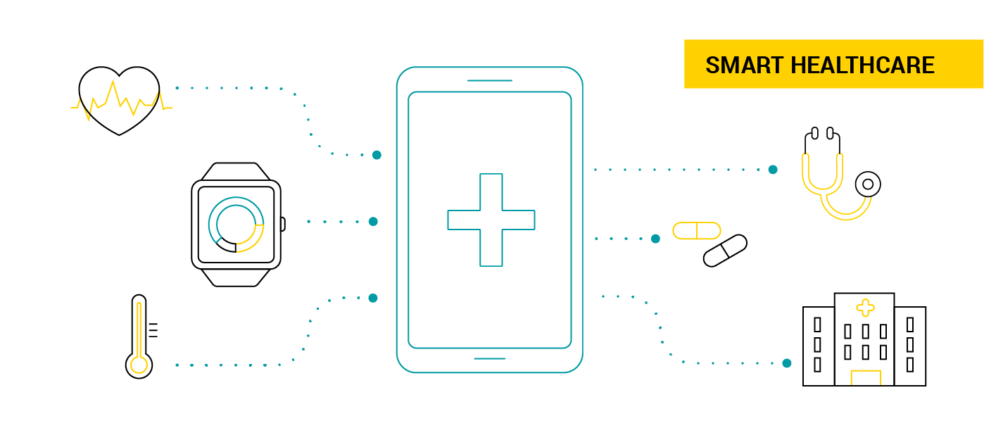

Slide 30
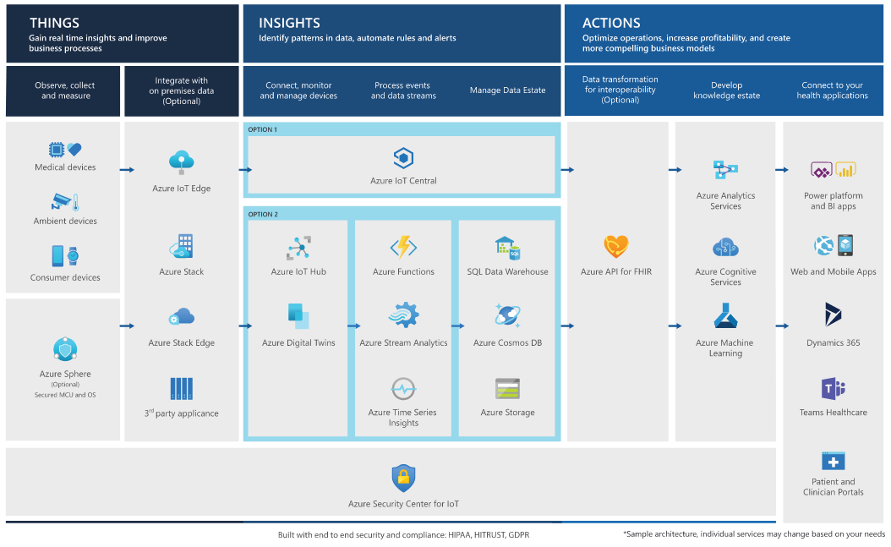

Slide 31
